Slide 1
Decentralized Crop Insurance Solution By Team Super Programmers
AI/ML & Blockchain Hackathon
Hosted By Icertis – TechGig 2019
A Blockchain technology based Crop Insurance Solution

Slide 2
Agenda
Problems with Traditional Insurance
Solution - Platform Description
The Stakeholders
Architecture
How It Works
Problems Being Solved
Technology/Tools Being Used

Slide 3
Problems with Traditional Insurance
Large Players Dominates the Market and Reap Benefits
Farmers Feel Treated Unfairly, Don’t Understand Policies
Insurance Companies Have Different Reasons To Not To Pay Out Claims
Insurance Companies are Having No Trust and Transparency
Tight Regulation is Needed to Protect Farmers
Conflict of Information Between Farmers and Insurance Companies

Slide 4
Solution - Platform Description
A Multi-Node Blockchain Network - Simulates Automatic Claim Settlement
The Solution Built Upon Ethereum Smart Contracts
Machine Learning Applied to The Weather Data Provides Useful Insights
Facilitates Farmers and other Stakeholders To Take Optimum Decisions
Predictive Models Provides High Value Predictions To Help Farmers To Decide
Crop Quality Recommendations
Crop Identification
Crop Yield Prediction
Crop Demand Prediction
Peer-To-Peer model – no need of any middleman to operate the system
Financial Transactions are Realized using a Digital Wallet

Slide 5
The Stakeholders
Farmers - Registers for Insurance
Weather Data Providers - Manages Weather Data
Insurance Companies
Service Provider - Design Insurance Policies
Technology Solution Provider – User Interface, Application and Blockchain Layer

Slide 6
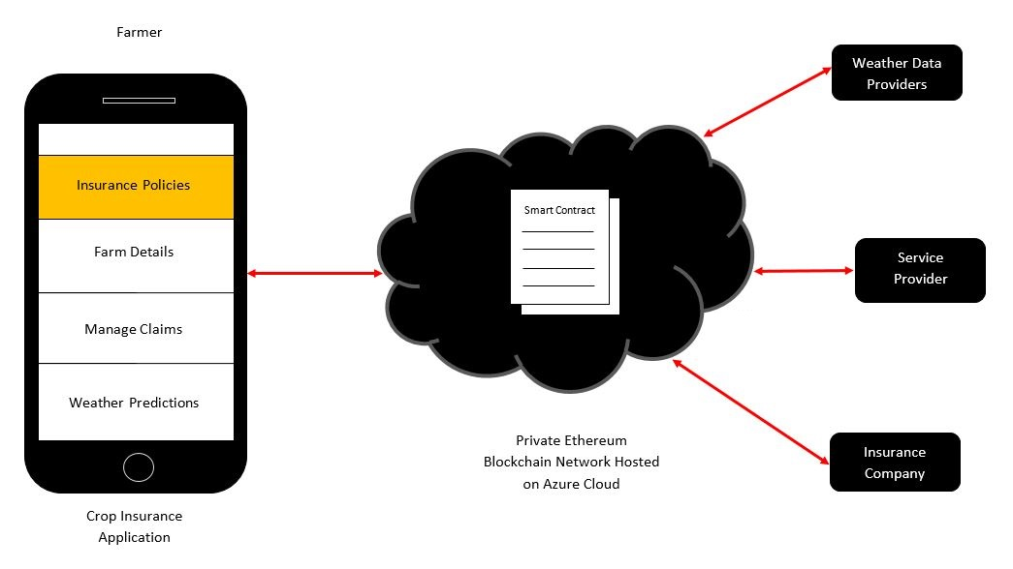
Architecture

Slide 7
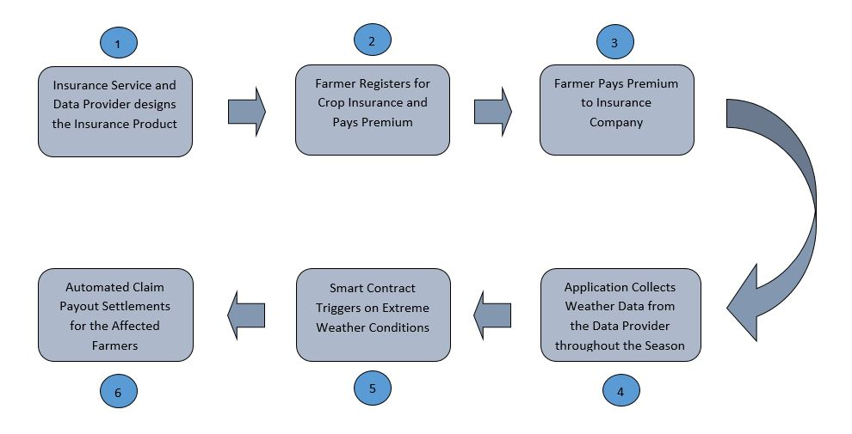
How It Works

Slide 8
How It Works…
Insurance Service and Data Providers Designs Insurance Product
Farmer Signs Up for Weather Insurance Product - Registration Data and Policy Data is Set Up with Smart Contract
Farmer Pays Premium to Insurance Company
Through the Season the Smart Contract Collects Weather Data from the Data Provider e.g.
Soil Temperature at different heights
Air Temperature
Leaf Wetness
Rainfall
Wind Speed
Relative Humidity
Solar Radiation
Wind Direction and Atmospheric Pressure
When Weather Threshold is reached, Smart Contract gets Triggered Automatically
Claim Payout happens to the Insured Farmer Automatically

Slide 9
Problems Being Solved
Increased Efficiency for Farmers
Fairer Payment for Farmers
Farmers can Quickly get the Claims through Smart Contracts
Farmers can Take Preventive Actions
Eliminates the lack of Trust and Transparency
Eliminates the Existence of Middleman
Decentralised System
More Secure

Slide 10
Demo/ Prototype
The
Blockchain Technology Based
Decentralized Crop Insurance Solution
–
Video - Crop Insurance Solution
GitHub - The Crop Insurance Solution

Slide 11
Technology Stack
Ethereum Smart Contracts – Solidity
Microsoft Azure – Cloud Platform to Host the Blockchain Service
Machine Learning – For Weather and Wind Data Analysis
HTML5, JavaScript, Node.js and Web3.js – User Interface
Ropsten TestNet – Test Framework
Truffle framework
MetaMask – Digital Wallet Provider
Remix IDE – Development Environment
Mobility – Mobile Interface

Slide 12
Deliverables
UI (User Interface)
DApp (Middleware to connect to Blockchain)
Smart Contracts
The Ethereum based Blockchain Network

Slide 13
Thank you
Team Super Programmers
Parvez Mulla
and
Sachin Jegaonkar

Slide 14
Extended Work – Application is Scalable
Scale this solution to Transform the Way Crops or Food Items are Produced to Improve the Quality Control and Food Safety
Scale this solution to Improve the Traceability in the Supply Chain and to Reduce the Food Frauds

